Slide 1
Simple Gui Calculator
By using Tkinter in Python : Project – 1

Slide 2
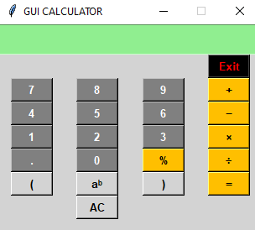
Introduction
What is Tkinter ?
Python's standard library for GUI programming.
Easy to use and available on all major platforms.
Project Overview:
Develop a basic calculator with a graphical user interface.
Perform basic arithmetic operations like addition, subtraction, multiplication, division and do other basic mathematical operations easily.
In the GUI calculator, all its operators and numbers are represented graphically and one can click it and use it.

Slide 3

Setting Up the Environment
Step 1: Install Python.
Step 2: Verify Tkinter installation:
Step 3: Designing the GUI
Components of the Calculator:
Display screen
Number buttons (0-9)
Operation buttons (+, -, *, /,%)
Equals button (=)
Clear button (AC)

Slide 4
Python Gui calculator
Screen for input/output
Use to exit for GUI Calculator
Numpad
Arithmetic Operator
For clear screen

Slide 5
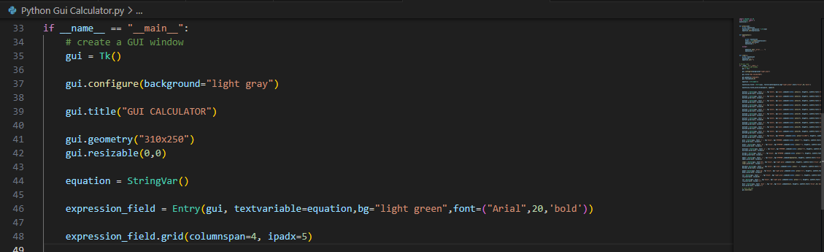
Creating the Main Window

Slide 6
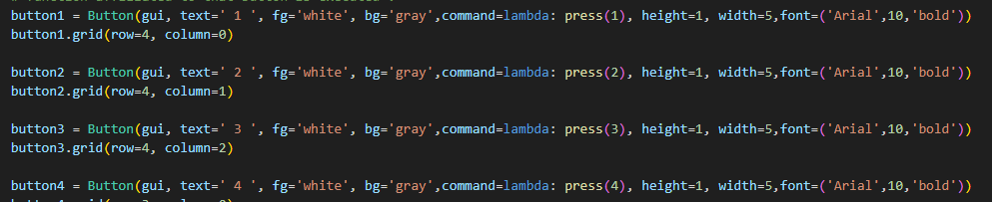
Adding Buttons

Slide 7
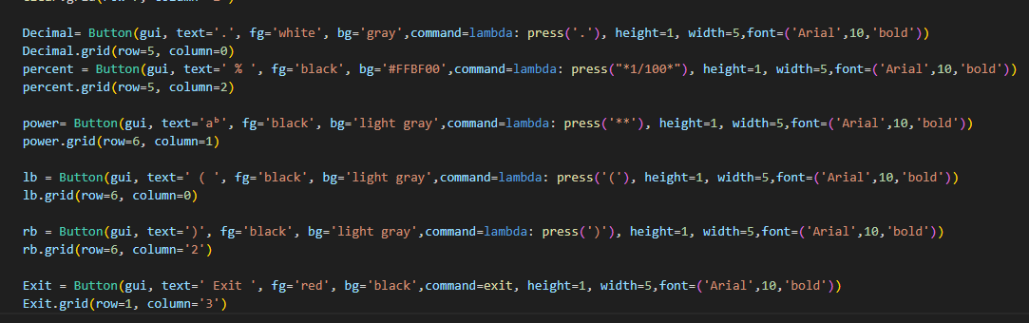
Adding some more important buttons:

Slide 8
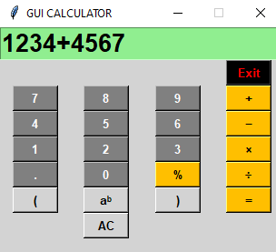
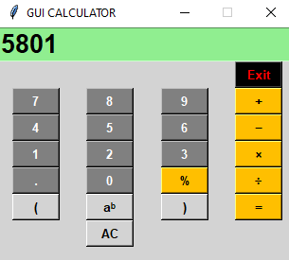
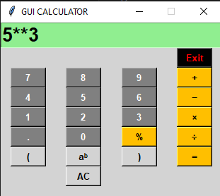
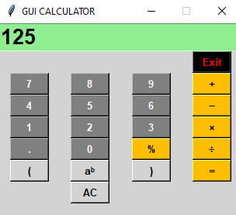
Perform operation graphically:
ADDITION
POWER

Slide 9
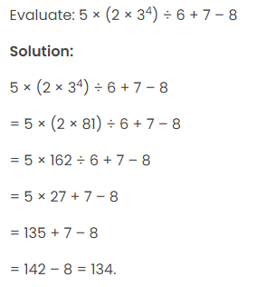
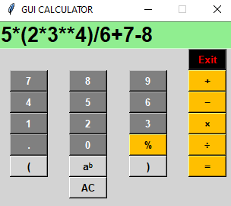
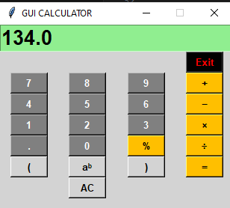
Bodmas rule operation :

Slide 10
Challenges and Learning
Challenges faced:
Aligning buttons within the grid.
Managing state and operations.
Learning outcomes:
Deep understanding of Tkinter widgets.
Improved skills in event handling and state management in Python.

Slide 11
Conclusion:
The Simple GUI Calculator project using Tkinter has been a rewarding experience, showcasing the power and versatility of Python's standard GUI toolkit. Through this project, we successfully created a functional and user-friendly calculator capable of performing basic arithmetic operations such as addition, subtraction, multiplication, and division.
Key accomplishments include:
Designing an intuitive graphical interface.
Implementing event-driven programming for button clicks.
Managing and displaying real-time results.

Slide 12
Thank you

